Slide 1
TABLEAU PROJECT: SALES INSIGHT
-By Ayusha Pandey

Slide 2
INDEPENDENT AND DEPENDENT VARIABLES
INDEPENDENT VARIABLE | DEPENDENT VARIABLE
1. Order Date | 1. Sales
2. Order Region | 2. Profit
3. Profit Margin%
4. Order Quantity
5. Product Category
6. Customer Segment
7. Shipping Mode
8. Discounts

Slide 3
CATEGORICAL & CONTINUOUS DATA
COLUMN NAME | TYPE
Order Date | Categorical
Order Region | Categorical
Product Category | Categorical
Customer Segment | Categorical
Shipping Mode | Categorical
Order ID | Categorical
Sales | Continuous
Profit Margin% | Continuous
Total Profit | Continuous
Order Quantity | Continuous

Slide 4
PROBLEM STATEMENT
Ques:- How do different regions and periods affect sales and profits?
Ans:- Sales and profits fluctuate across regions and seasons due to customer preferences, seasonality and operational efficiency. Some regions and periods perform exceptionally well while others highlight areas for improvement. Understanding these patterns helps business plan better promotion, manage inventory and refine strategies for growth and success.

Slide 5
DATA UNDERSTANDING
Number of rows:- 115,746
Number of columns:- 20
Data types:-
Object (Categorical): 11 columns (e.g., Category Name, Customer Segment, Market)
Numeric (Continuous): 5 columns (e.g., Product Price, Profit Per Order, Sales)
Integer: 4 columns (e.g., Order ID, Order Quantity, Customer ID)

Slide 6
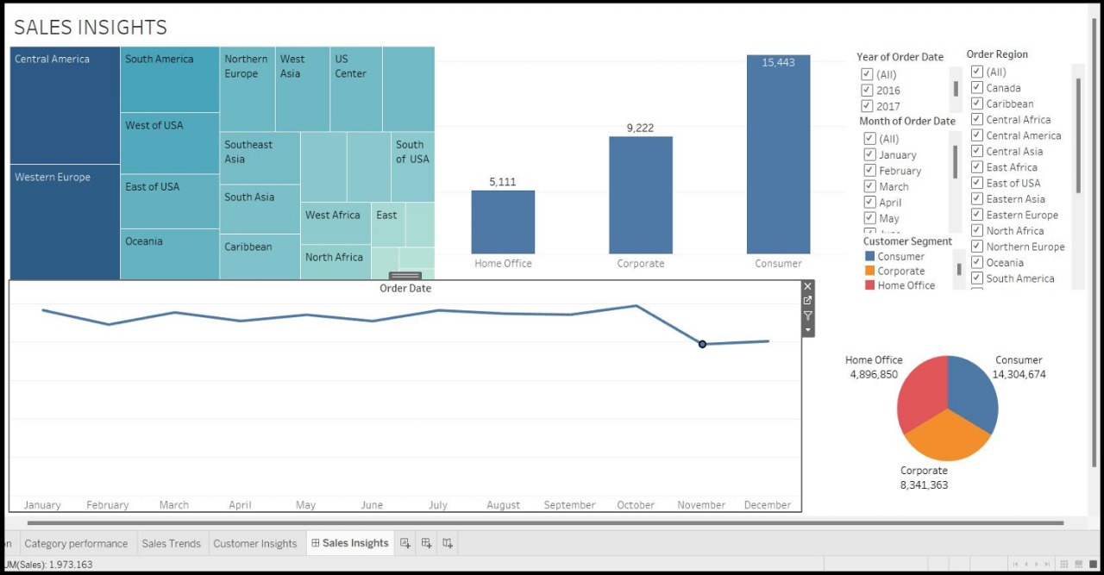
DASHBOARD

Slide 7
SOLUTIONS & RECOMMENDATIONS
Focus on profitable product categories.
Taylor marketing strategies for low-performing regions.
Optimise inventory based on sales trends.

